Slide 1
2. R Basics
Haiyan Cheng
Willamette University
CS-429
Spring 2018

Slide 2
History of R
S: An interactive environment for data analysis developed at Bell lab in 1976
R: Initially written by Ross Ihaka and Robert Gentlemen at Dep. Of Statistics of U of Auckland, New Zealand during 1990s.
Since 1997, international “R-core” team of 15 people have access to comnon CVS archive.

Slide 3
Why R
R is “GNU S”-A language and environment for data manipulation, calculation and graphic display
The core of R is an interpreted computer language
It is possible for the user to interface to procedures written in C, C++ or Fortran

Slide 4
Why R
R has many libraries. Suitable for data processing and analysis
Built-in data structure to help organizing data naturally
Element-wise operations
Business perspective:
https://www.simplilearn.com/r-programming-language-business-analytics-quick-guide-article

Slide 5
What R does and does not
Data handling and storage: numerical, textual
Matrix algebra
Hash table and regular expression
High level data analytic and statistical functions
Classes (“OO”)
Programming language: loops, branching, subroutines
Is not a database, but connects to DBMSs
Language interpreter is very slow but allows to call own C/C++ code
No spreadsheet view of data but connect o Excel and office

Slide 6
Pros and Cons
Open source
Easy to learn, easy to plot
Easy to reproduce & modify
Lots of high quality packages
Difficult to master
Confusing syntax for programmers
Designed to be easier for non-programmers

Slide 7
Installation
R standard: https://cran.cnr.berkeley.edu/
R Studio: https://www.rstudio.com/products/rstudio/download/

Slide 8
Basic type and data structure
Integer
Double
Boolean
Character
Factor
R assignment operator:
https://stat.ethz.ch/R-manual/R-devel/library/base/html/assignOps.html

Slide 9
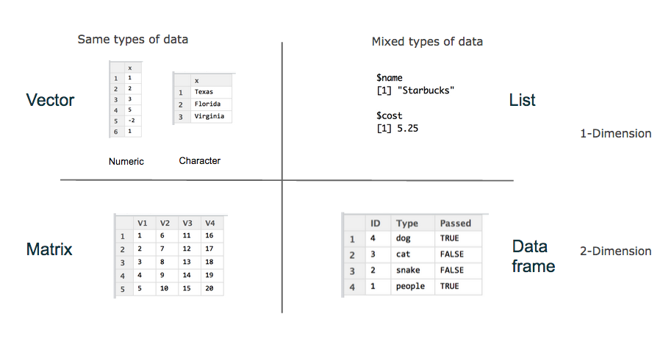
Collections

Slide 10
Vectors
A list of same typed items
v = c(1, 2, 4, 8, 16)
Index starts from 1, not 0
v = v + 6
v = v + v
v[c(1, 3)] select element 1 and 3
v[which (v > 5)]
v[which (v > 5 & v < 16)]

Slide 11
Matrix
2D vector, rectangle shape
matrix(nrow = 2, ncol = 3)
matrix(1:6, nrow = 2)
matrix(1:6, nrow = 2, byrow = TRUE)
Array is a n-dim matrix

Slide 12
Matrix
cbind() and rbind()—add a row or a col to the end of the existing matrix
m = matrix(1:6, nrow = 2, byrow = TRUE)
m = rbind(m, 7:9)
colnames(m) = c(“one”, “two”, “three”)
rownames(m) =c(“top”, “middle”, “bottom”)
m*2
m**2

Slide 13
Type Coersion
M[1,1] = “A”
Observe how the type of m changes

Slide 14
Lists
An ordered collection of data of arbitrary types.
doe = list(name = “John”, age = 28, married = F)
doe$name
doe$age
food <- list(“potato”, 163, 0.2, 37.0, 4.3)
names(food) <- c(“type”, “calories”, “fat”, “carbs”, “protein”)
food
or
food <- list(type = “potato”, calories = 163, fat = 0.2, carbs = 37.0, protein = 4.3)
Typically, vector elements are accessed by their index (an integer), list elements by their name (a character string). But both types support both access methods.

Slide 15
Useful functions
length(object)
str(object)
class(object)
names(object)
c(object, object, ...)
cbind()
rbind()
object
ls()
rm(object)
newobject<- edit(object) # edit coy and save as new object
fix(object) # edit in place

Slide 16
Factors
Categorical variables-fixed set of values
As a vector
Blood = c(“B”,“AB”, “O”, “A”, “O”)
As a factor
Blood_factor = factor(blood)
Levels are sorted alphabetically (one “O” level)
Unless you specify ordered

Slide 17
Data frames
A powerful data structure
Rows are observations
Columns are variables
Elements in a single column must be of the same type
Declare a data frame:
Roster <- data.frame(ID = integer(), FirstName=character(), LastName=character(), Grade=factor(levels = c(“A”, “A-”, “B+”, ... , “F”)), stringAsFactors=FALSE)
Can also read from files using read.table()

Slide 18
Data frames
head(roster)
summary(roster)
roster$FirstName
roster[[“FirstName”]]
roster$Grade[2]
roster$ID[which(roster$Grade == “A”)]

